Slide 1
Analysis in Mobility Dataset

Slide 2
Dataset
MiD 2017 ¶
Mobilität in Deutschland
Size: 892627 data points( travel length)
NHTS17
Travel behavior of the American public
Size: 923572 data points
 | Mode | # of samples
MiD 2017 | Bike | 102237
 | Car | 404637
 | Short Range | 74215
 | Long Range | 4884
Nhts 2017 | Bike | 8034
 | Car | 797169
 | Short Range | 26273
 | Long Range | 2401

Slide 3
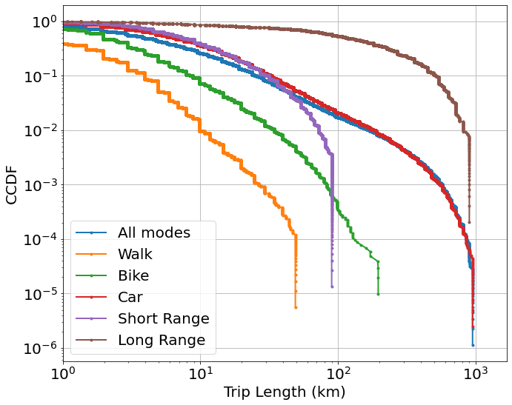
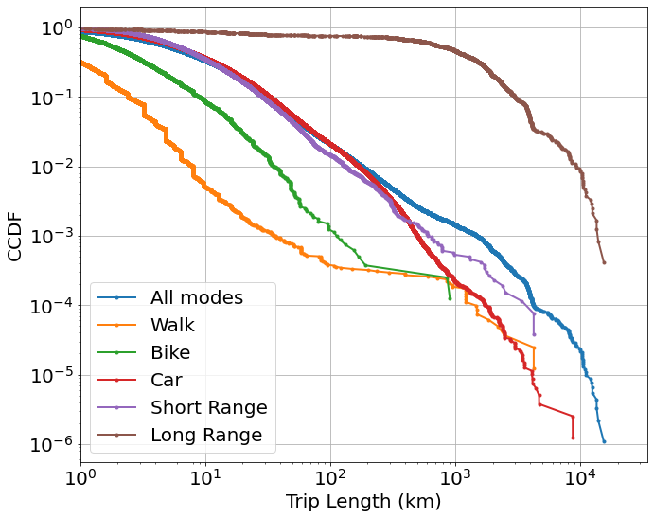
CCDF of both datasets
MiD 2017¶
Nhts 2017¶

Slide 4

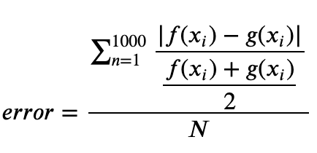
For real data
To measure the distance between two distributions (can be different length)

Slide 5
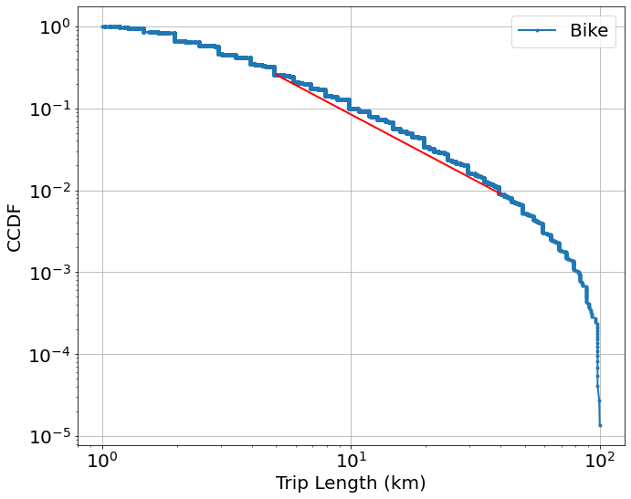
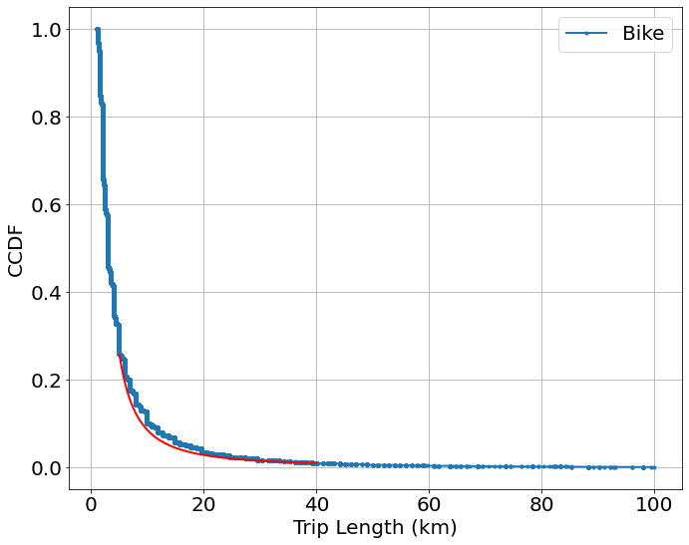
Bike in MiD 2017 between 1km~100km
Datasize=73489
Distance (error): 0.2205318870682493
X1 | 5 | Y1 | 0.25703166 | C | 3.43721685
X2 | 40 | Y2 | 0.00901315 | alpha | 1.61125699

Slide 6
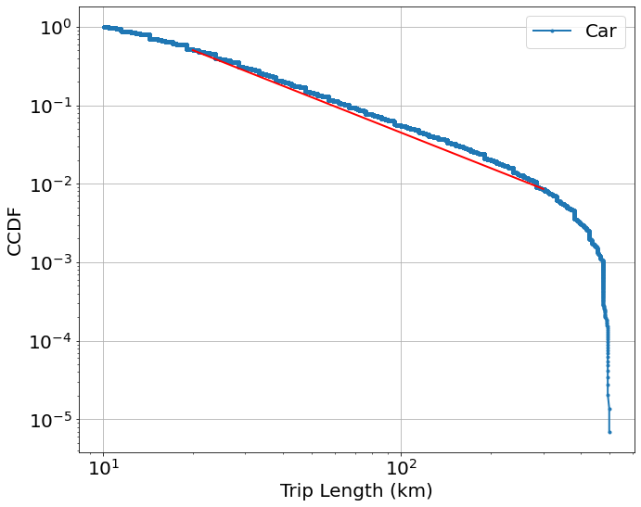
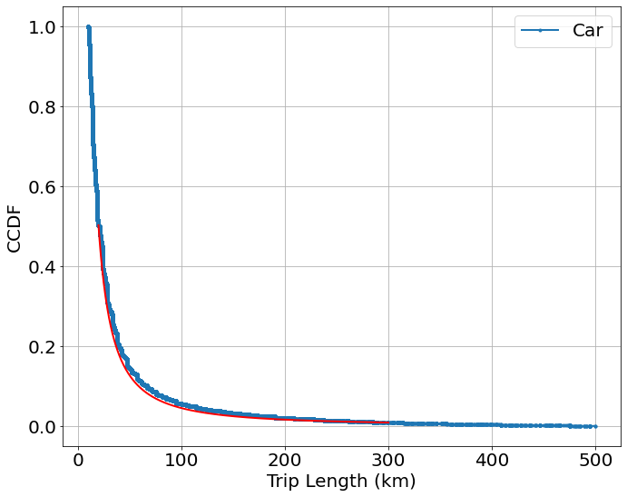
Car in MiD 2017 between (keep) 10km~500km
Datasize=144881
Distance (error): 0.19570825649776477
X1 | 20 | Y1 | 0.5023490542813297 | C | 45.19417243144977
X2 | 300 | Y2 | 0.00860161461003025 | alpha | 1.501946039505492

Slide 7
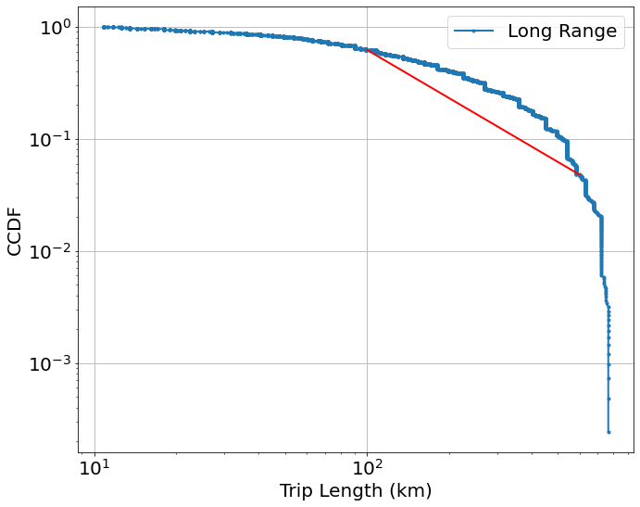
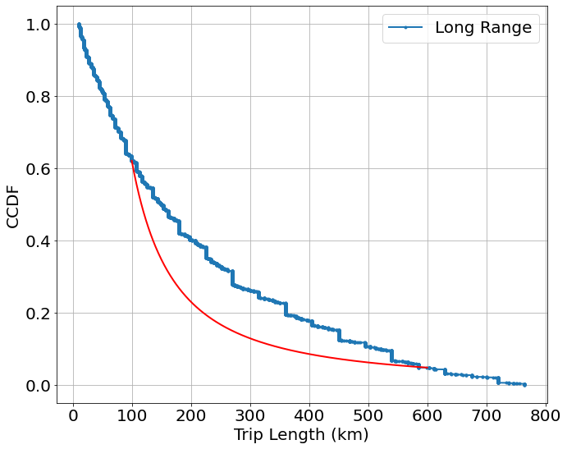
Long Range in MiD 2017 between 10~800km
Datasize=4129
Distance (error): 0.513609318079753
X1 | 100 | Y1 | 0.620717956997928 | C | 448.8287598322465
X2 | 600 | Y2 | 0.04791313473803180 | alpha | 1.4295931841028626

Slide 8


Car in Nhts17 between (keep) 10~500km
Datasize=291504
Distance (error): 0.24274767454622478
X1 | 20 | Y1 | 0.5183412415164247 | C | 60.495826819509766
X2 | 300 | Y2 | 0.00701474623909458 | alpha | 1.5888255144474328

Slide 9
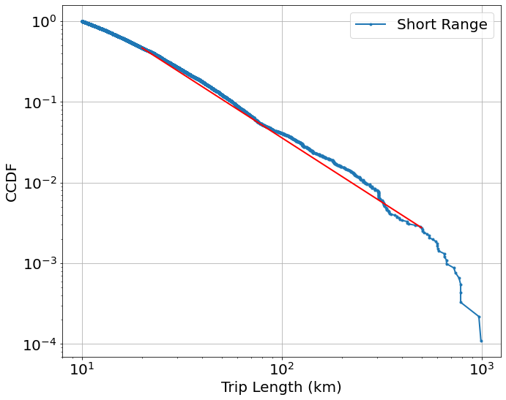
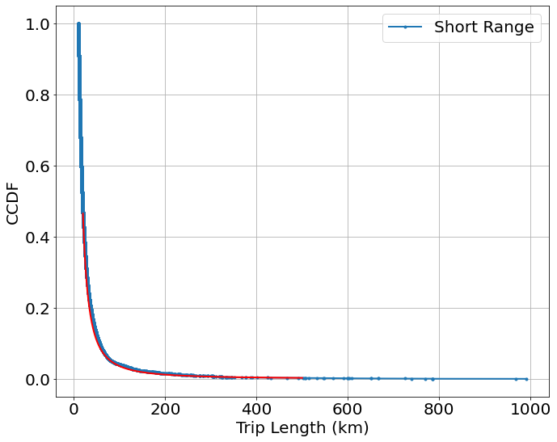
Short Range in Nhts17 between (keep) 10~1000km
Datasize=9130
Distance (error): 0.15377739948645244
X1 | 20 | Y1 | 0.46514486675815236 | C | 54.88584238995587
X2 | 500 | Y2 | 0.00276304710144906 | alpha | 1.592486036855698

Slide 10
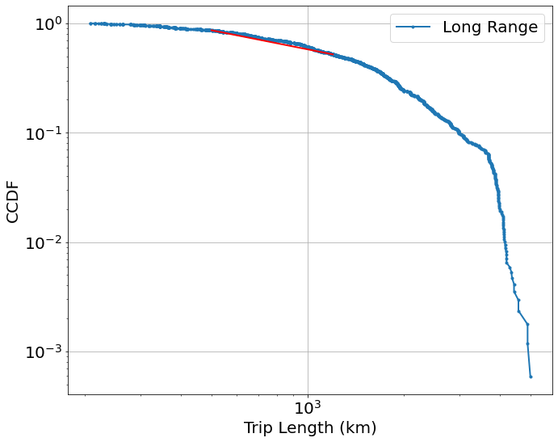
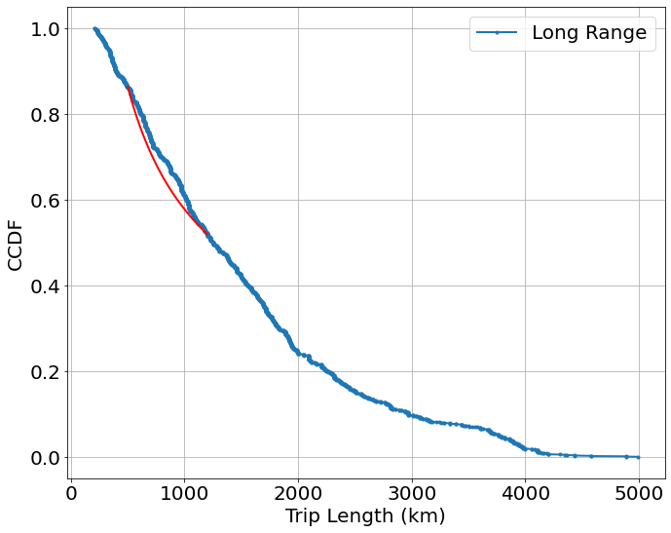
Long Range in Nhts17 between 200~5000km
Datasize=1698
Distance (error): 0.04287572464985327
X1 | 500 | Y1 | 0.8635434716755086 | C | 31.63333854808154
X2 | 1200 | Y2 | 0.5199707089842467 | alpha | 0.5794287530055374

Slide 11
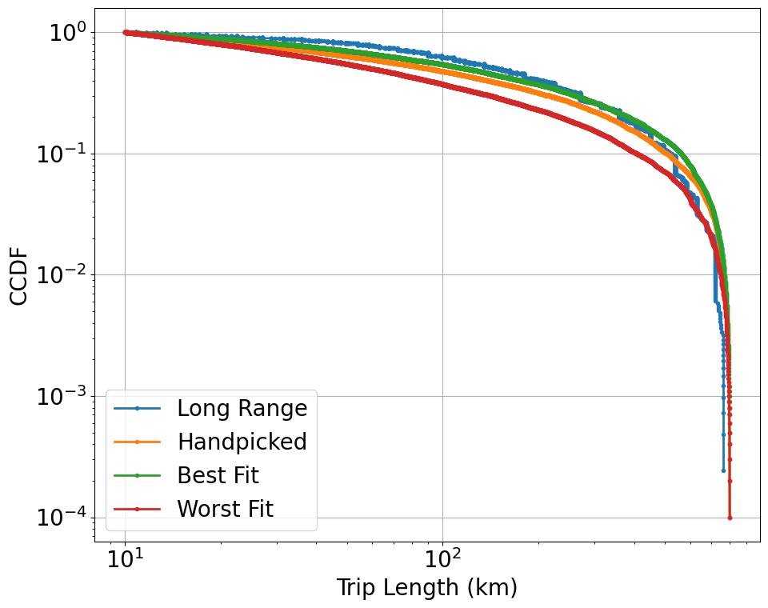
Long Range Public in MiD 2017 Limited range distances(10km~800km) selected for modelling (new)
Datasize=4129
Best fit error:
0.15249471264821887
Worst fit error
0.5474726170367411
eps_range=np.arange(0.8,1.2,0.05)
p_range=np.arange(0.7, 0.97, 0.03)
alp_range=np.arange(1.02, 1.3,0.03)
Error: customized
Samples:
Modelling(1000), Visualization(10000)
 | eps | p | alpha
Hand picked | 2 | 0.7 | 1.1
Best fit | 1.15 | 0.94 | 1.08
Worst fit | 0.85 | 0.7 | 1.29

Slide 12
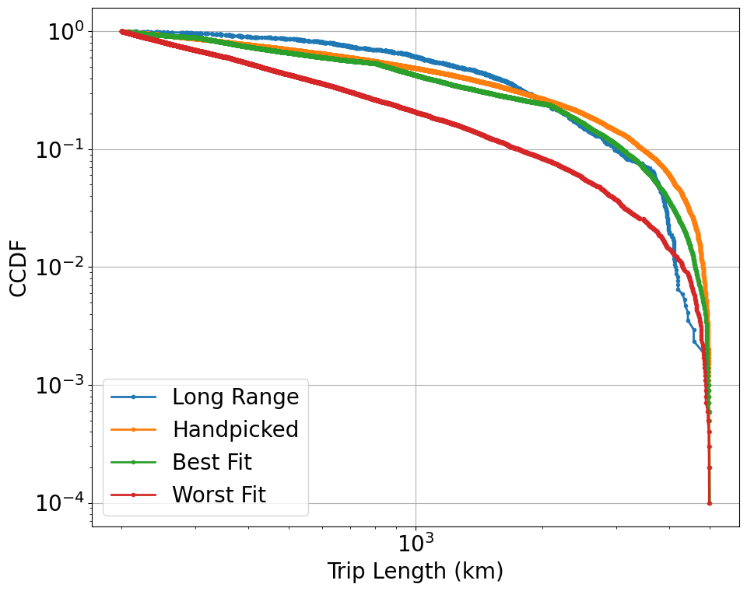
Long Range Public in Nhts 2017 Limited range distances(200km~5000km) selected for modelling (new)
Datasize=1698
Best fit error:
0.30965332946558627
Worst fit error
0.8336170717434674
eps_range=np.arange(0.8,1.8,0.1)
p_range=np.arange(0.6, 0.95, 0.05)
alp_range=np.arange(1.1, 2.5,0.1)
Error: customized
Samples:
Modelling(1000), Visualization(10000)
 | eps | p | alpha
Hand picked | 2 | 0.7 | 1.1
Best fit | 1.6 | 0.85 | 2.3
Worst fit | 0.8 | 0.6 | 2.1

Slide 13
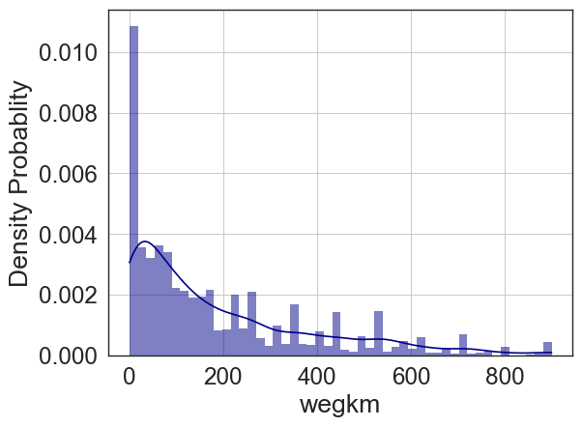
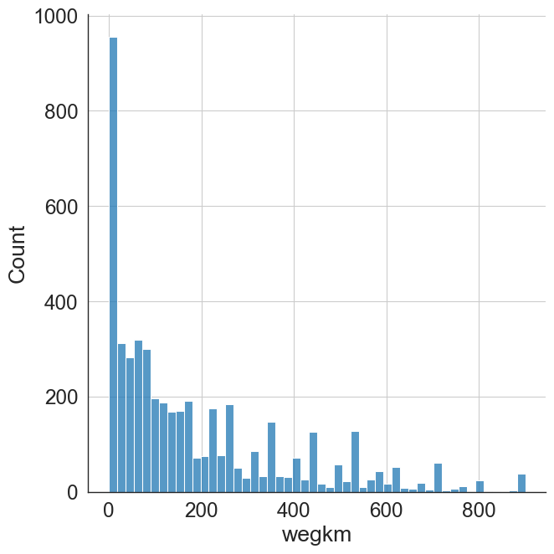
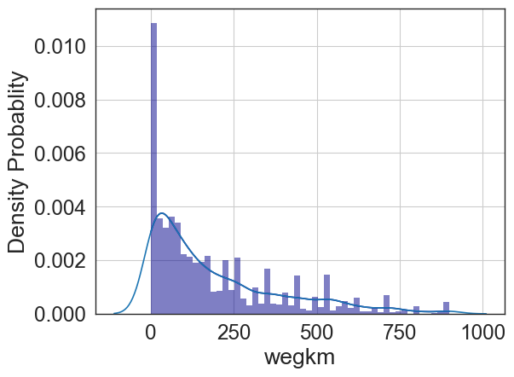
Histogram and Smoothing
Data: Long Range in MiD 2017
Bins=50
Right side: Kernel density estimate (KDE) plot, Gaussian kernel, which produces a Gaussian bell curve at each data point

Slide 14
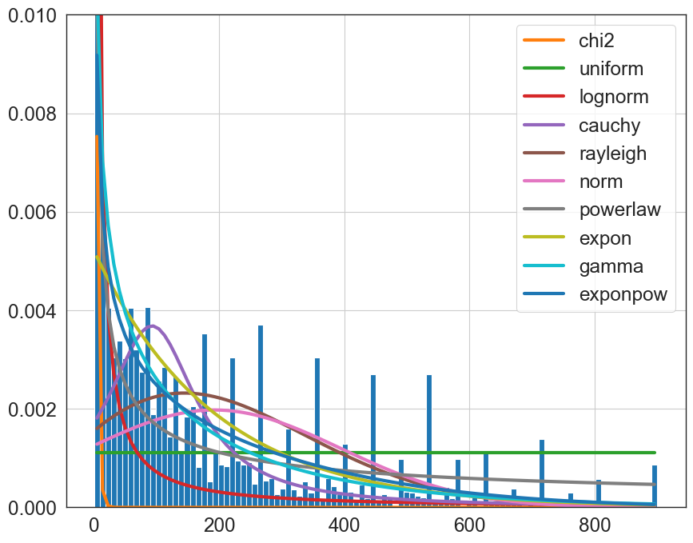
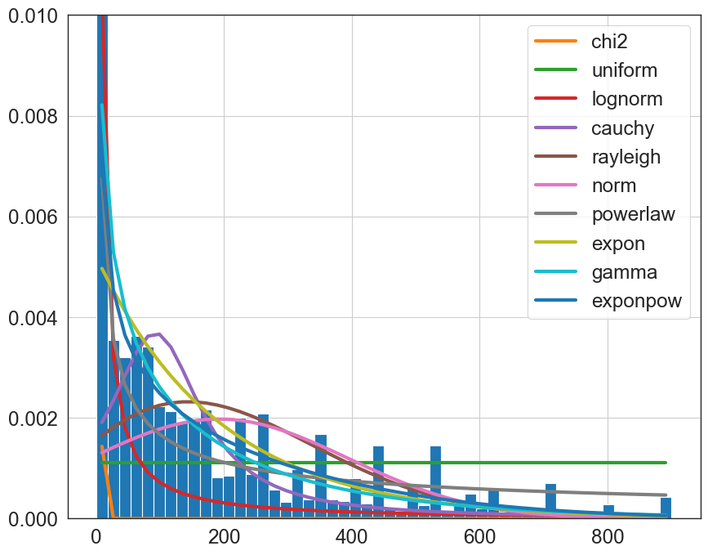
Possible distributions
Data: Long Range in MiD 2017
Scoring Method: ks-pvalue (p-value of Kolmogorov-Smirnov test)
Bins: default bins=100 (left side); right side = 50

Slide 15
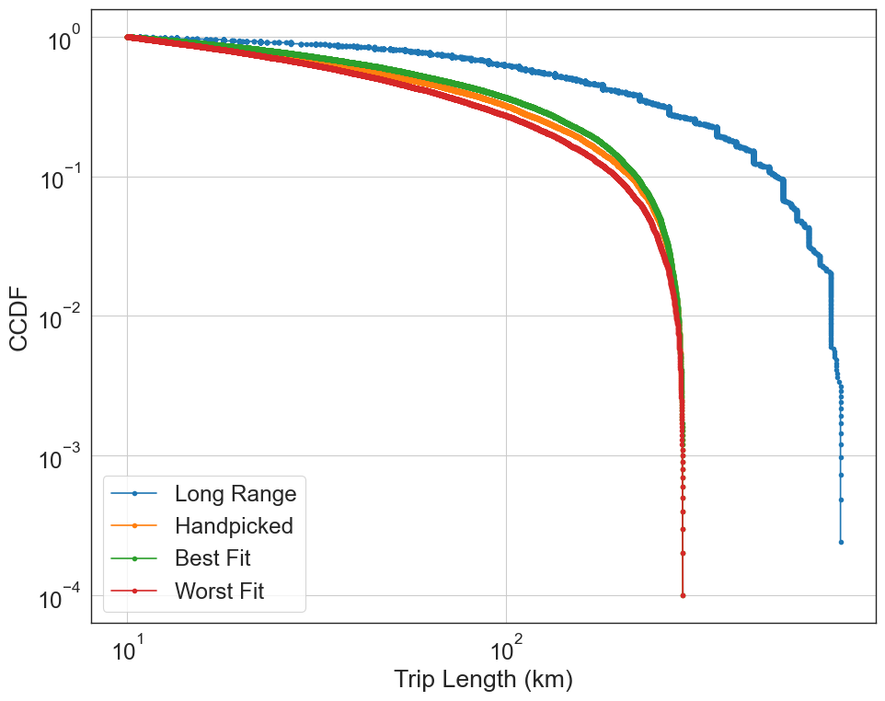
Long Range Public in MiD 2017 Limited distances(10km~900km) Dynamic Maximum Distance selected
Datasize=4129
Best fit error:
0.6797937915287383
Worst fit error
1.3491236492867646
eps_range=np.arange(0.8,1.2,0.05)
p_range=np.arange(0.7, 0.97, 0.03)
alp_range=np.arange(1.02, 1.3,0.03)
Error: customized
Samples:
Modelling(1000), Visualization(10000)
 | eps | p | alpha
Hand picked | 2 | 0.7 | 1.1
Best fit | 0.9 | 0.88 | 1.02
Worst fit

Slide 16
2023.03.08

Slide 17
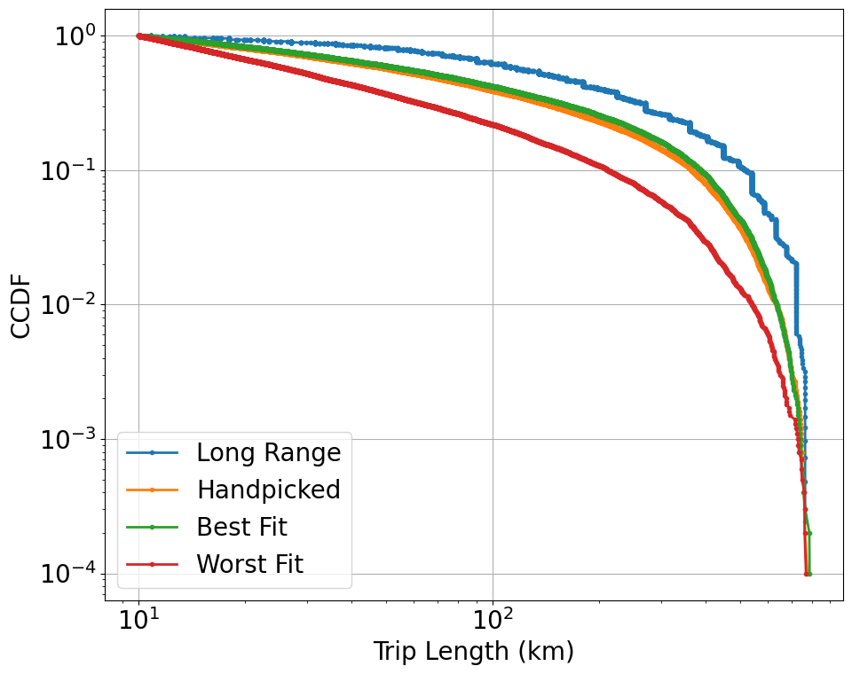
Long Range Public in MiD 2017 Limited distances(10km~[400~800km]) Dynamic Maximum Distance
Datasize=4129
Best fit error:
0.43615352310724226
Worst fit error
1.4031687147621725
eps_range=np.arange(0.6,1.2,0.05)
p_range=np.arange(0.3, 0.98, 0.03)
alp_range=np.arange(1.02,1.5,0.03)
Error: customized
Samples:
Modelling(1000), Visualization(10000)
 | eps | p | alpha
Hand picked | 2 | 0.7 | 1.1
Best fit | 0.75 | 0.45 | 1.02
Worst fit | 0.7 | 0.86 | 1.47

Slide 18
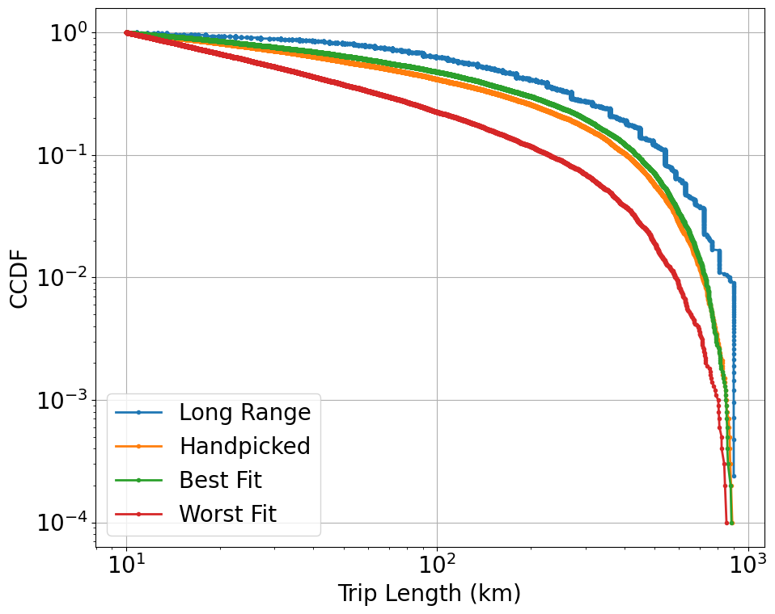
Long Range Public in MiD 2017 Limited distances(10km~[450~900km]) Dynamic Maximum Distance
Datasize=4199
Best fit error:
0.3640925552728071
Worst fit error
1.4116213809023332
eps_range=np.arange(0.6,1.2,0.05)
p_range=np.arange(0.3, 0.98, 0.03)
alp_range=np.arange(1.02,1.5,0.03)
Error: customized
Samples:
Modelling(1000), Visualization(10000)
 | eps | p | alpha
Hand picked | 2 | 0.7 | 1.1
Best fit | 1.15 | 0.3 | 1.05
Worst fit | 0.95 | 0.9 | 1.47

Slide 19
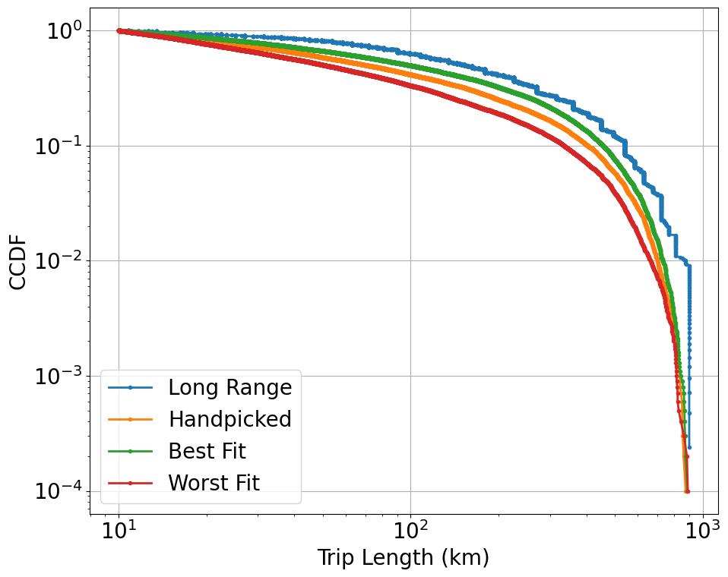
Long Range Public in MiD 2017 Limited distances(10km~[450~900km]) Dynamic Maximum Distance
Datasize=4199
Best fit error:
0.1827946659535188
Worst fit error
1.1014700678318898
eps_range=np.arange(0.9,1.2,0.02)
p_range=np.arange(0.1, 0.5, 0.01)
alp_range=np.arange(1.02,1.3,0.01)
Error: customized
Samples:
Modelling(1000), Visualization(10000)
 | eps | p | alpha
Hand picked | 2 | 0.7 | 1.1
Best fit | 1.02 | 0.22 | 1.02
Worst fit | 0.98 | 0.48 | 1.3

Slide 20
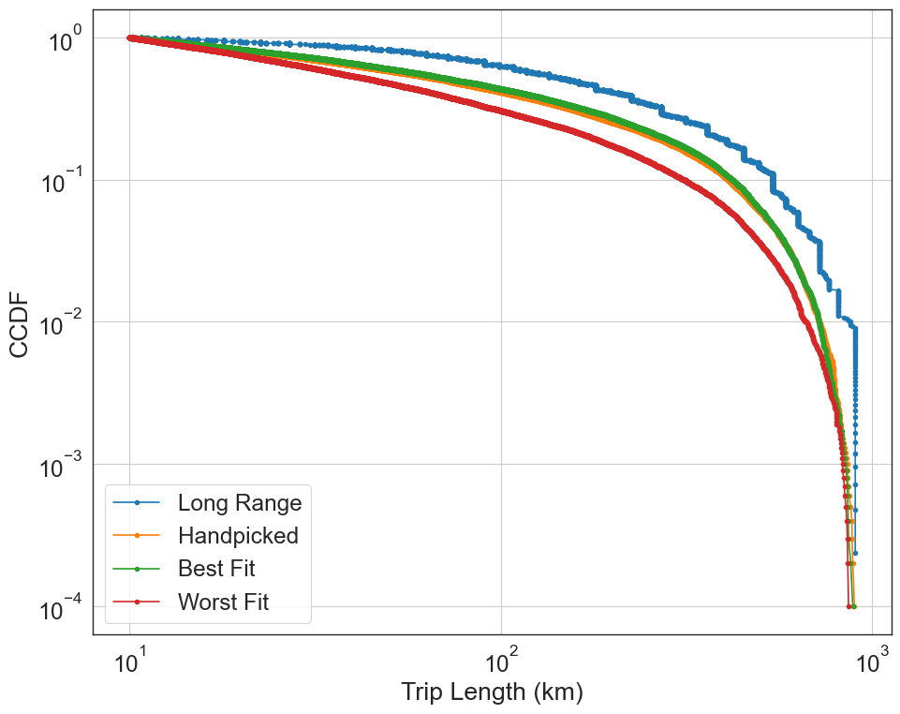
Correction: Long Range Public in MiD 2017 Limited distances(10km~[450~900km]) Dynamic Maximum Distance
Datasize=4199
Best fit error:
0.21745521674534815
Worst fit error
0.9663312024354147
eps_range=np.arange(0.9,1.2,0.02)
p_range=np.arange(0.7, 0.95, 0.02)
alp_range=np.arange(1.02,1.3,0.02)
Error: customized
Samples:
Modelling(1000), Visualization(10000)
 | eps | p | alpha
Hand picked | 2 | 0.7 | 1.1
Best fit | 1.1 | 0.94 | 1.02
Worst fit | 1.14 | 0.72 | 1.3

Slide 21
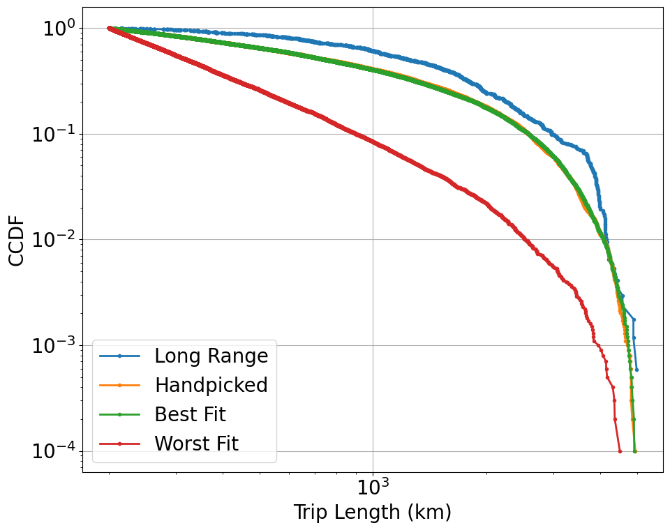
Long Range Public in Nhts 2017 Limited distances(200km~[2500~5000km]) Dynamic Maximum Distance
Datasize=1698
Best fit error:
0.2744291709562464
Worst fit error
1.6600731885690052
eps_range=np.arange(0.8,1.8,0.1)
p_range=np.arange(0.6, 0.95, 0.03)
alp_range=np.arange(1.1, 2.5,0.1)
Error: customized
Samples:
Modelling(1000), Visualization(10000)
 | eps | p | alpha
Hand picked | 2 | 0.7 | 1.1
Best fit | 1 | 0.63 | 1.1
Worst fit | 1 | 0.93 | 2.4

Slide 22
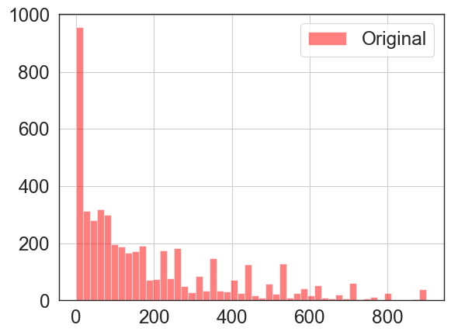
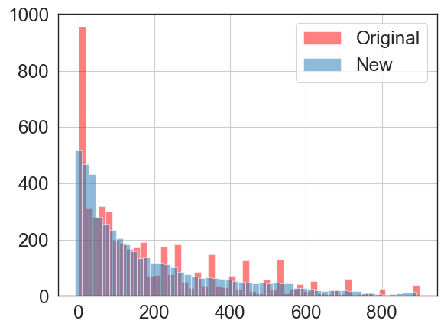
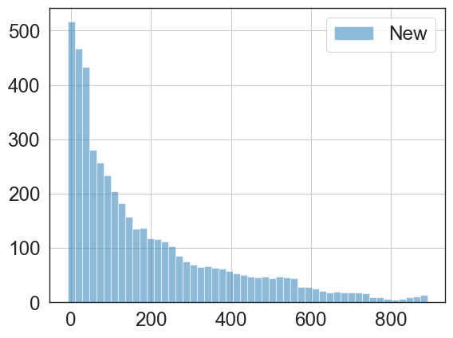
Histogram and Smoothing
Data: Long Range in MiD 2017
Bins=50
Average two neighbours
After smoothing, no raw data

Slide 23
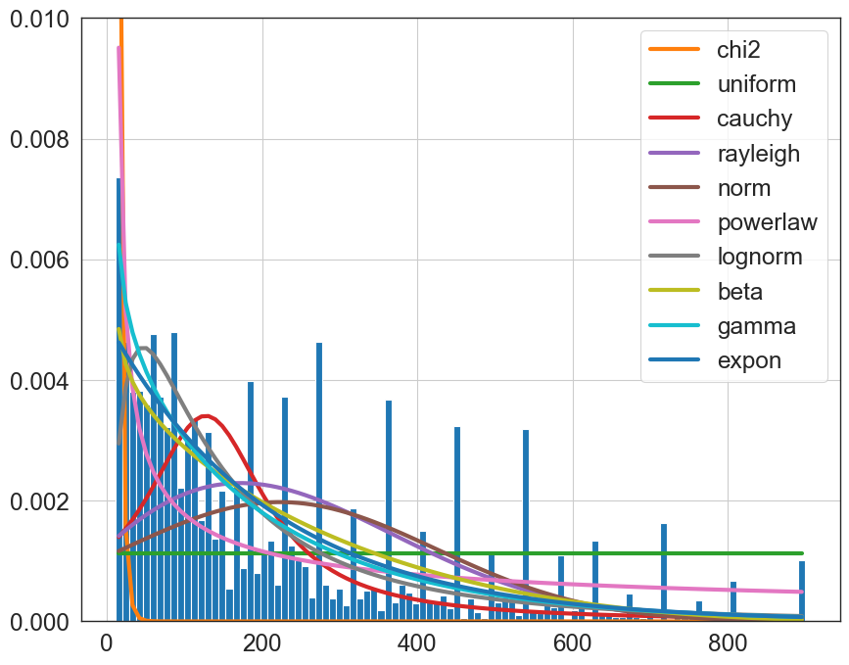
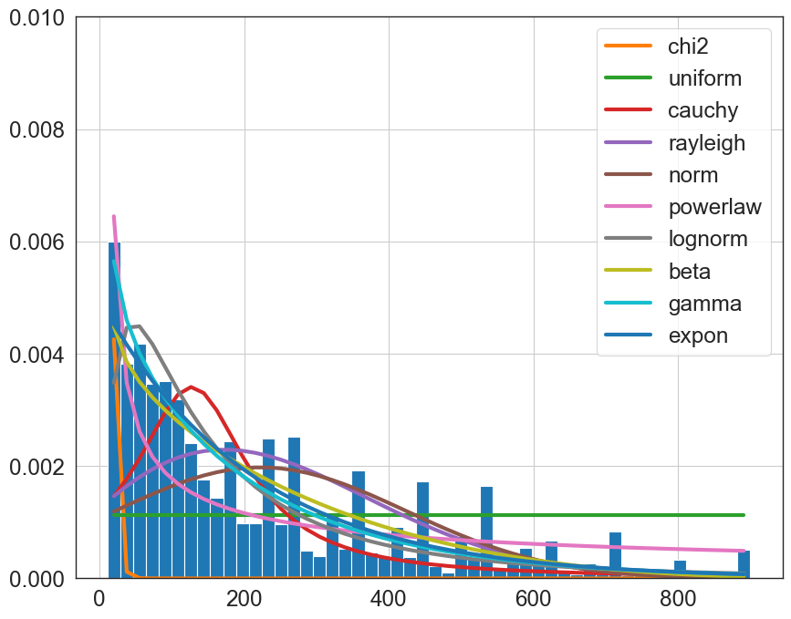
Possible Distributions to fit the Data Long Range in MiD 2017
100 bins histogram
50 bins histogram

Slide 24
2023.03.14

Slide 25
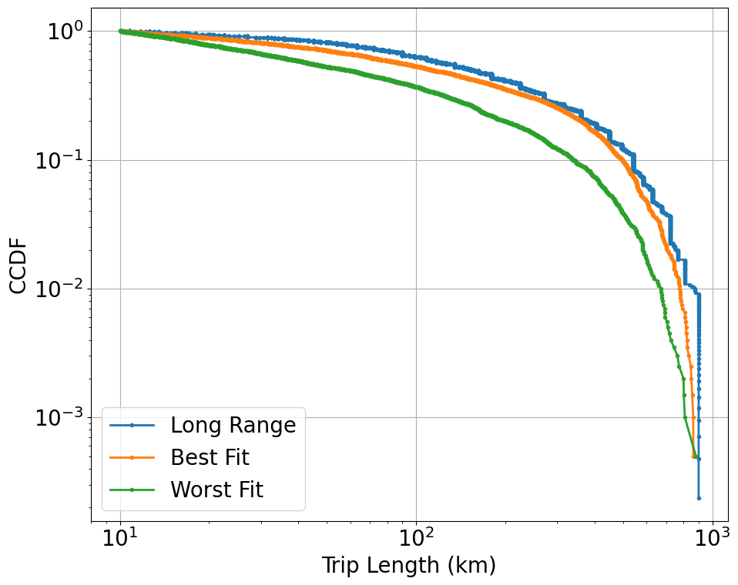
Long Range Public in MiD 2017 Limited distances(10km~[450~900km]) Dynamic Maximum Distance
Datasize=4199
Best fit error:
0.29442299923521226
Worst fit error
0.9970833764002673
eps_range=np.arange(0.9,1.2,0.02)
p_range=np.arange(0.7, 0.95, 0.01)
alp_range=np.arange(1.02,1.3,0.01)
Error: customized
Samples:
Modelling (Visualization in the same time) 2000 →the error for fitting is the same error in the plot
 | eps | p | alpha
Hand picked
Best fit | 1 | 0.94 | 1.05
Worst fit | 0.98 | 0.73 | 1.3

Slide 26
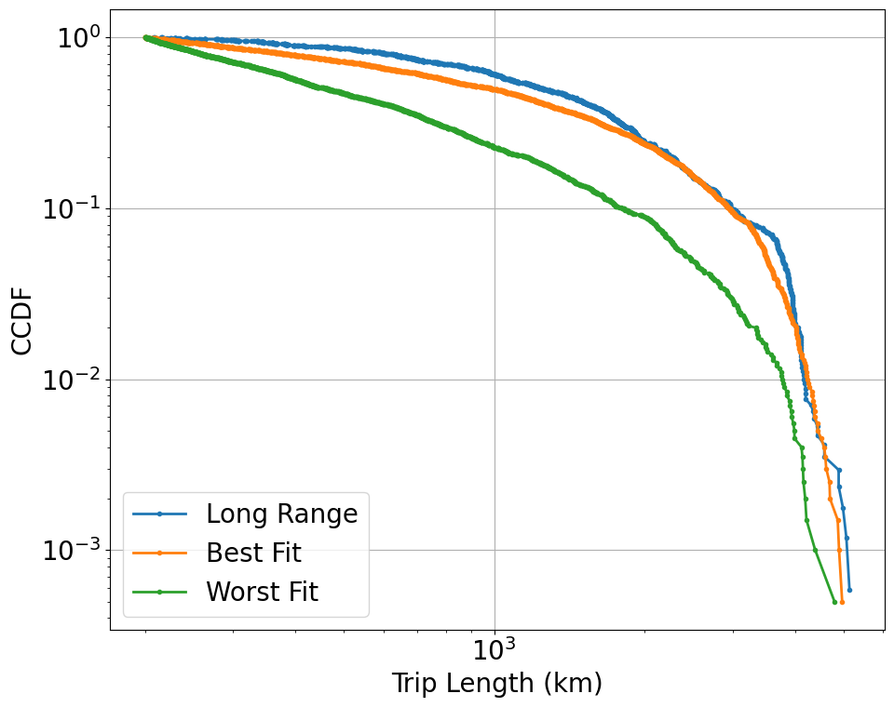
Long Range Public in Nhts 2017 Limited distances(200km~[2600~5200km]) Dynamic Maximum Distance
Datasize=1700
Best fit error:
0.18388860715554078
Worst fit error
1.0532352544744417
eps_range=np.arange(0.8,1.8,0.1)
p_range=np.arange(0.7, 0.95, 0.01)
alp_range=np.arange(1.02, 2.5,0.1)
Error: customized
Samples:
Modelling (Visualization in the same time) 2000 →the error for fitting is the same error in the plot
 | eps | p | alpha
Hand picked
Best fit | 1.7 | 0.93 | 1.02
Worst fit | 0.8 | 0.7 | 2.32

Slide 27
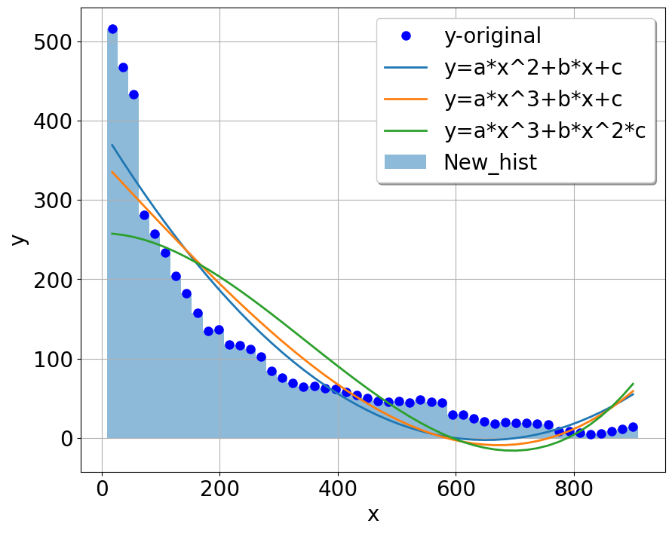
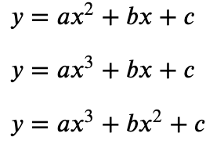
Smoothing Histogram and Fitting Curve
Data: Long Range in MiD 2017
Bins=50
Average two neighbours
After smoothing, no raw data
Tested Functions:

Slide 28
2023.03.22

Slide 29
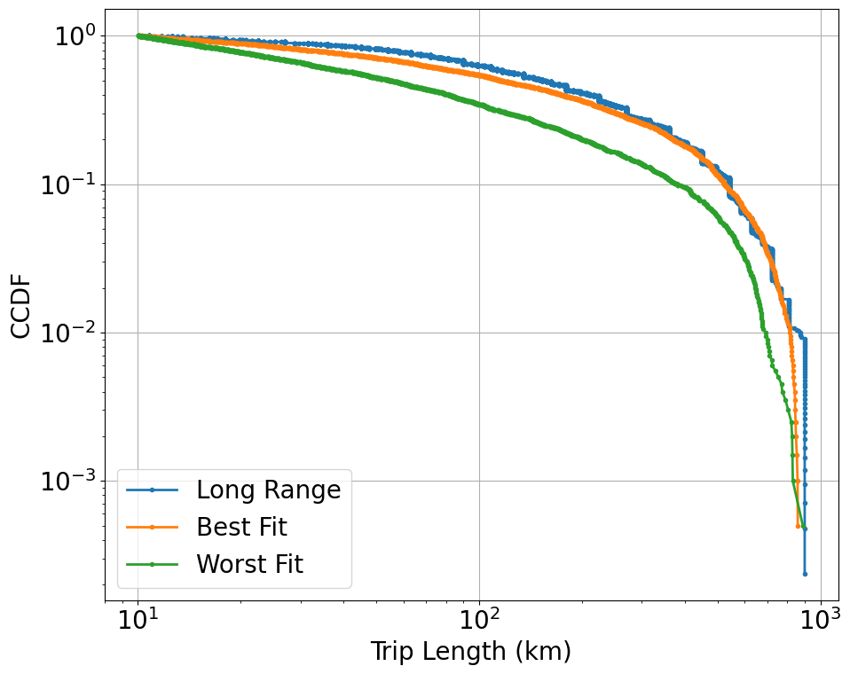
Long Range Public in MiD 2017 Limited distances(10km~[450~900km)) Dynamic Maximum Distance
Datasize=4199
Best fit error:
0.1380387123367084
Worst fit error
0.8285046642826611
eps_range=np.arange(0.9,1.2,0.02)
p_range=np.arange(0.7, 0.95, 0.01)
alp_range=np.arange(1.02,1.3,0.01)
Error: customized
Maximum Distance Selection: new uniformly
Samples:
Modelling (Visualization in the same time) 2000 →the error for fitting is the same error in the plot
 | eps | p | alpha
Hand picked
Best fit | 0.9 | 0.91 | 1.03
Worst fit | 0.94 | 0.71 | 1.3

Slide 30
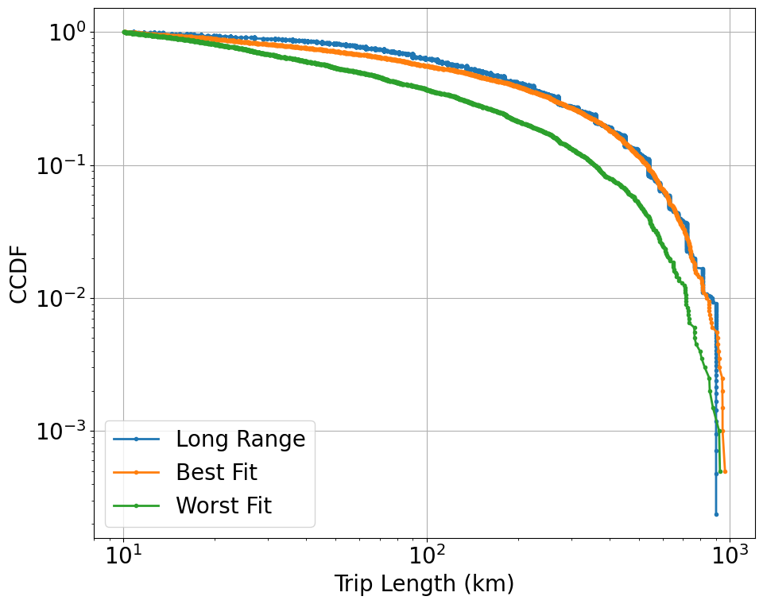
Long Range Public in MiD 2017 Limited distances(10km~[500~1000km)) Dynamic Maximum Distance
Datasize=4199
Best fit error:
0.09173325414705914
Worst fit error
0.8211790328682269
eps_range=np.arange(0.9,1.2,0.02)
p_range=np.arange(0.7, 0.95, 0.01)
alp_range=np.arange(1.02,1.3,0.01)
Error: customized
Maximum Distance Selection: uniformly
Samples:
Modelling (Visualization in the same time) 2000 →the error for fitting is the same error in the plot
 | eps | p | alpha
Hand picked
Best fit | 1.02 | 0.94 | 1.02
Worst fit | 0.98 | 0.74 | 1.29

Slide 31
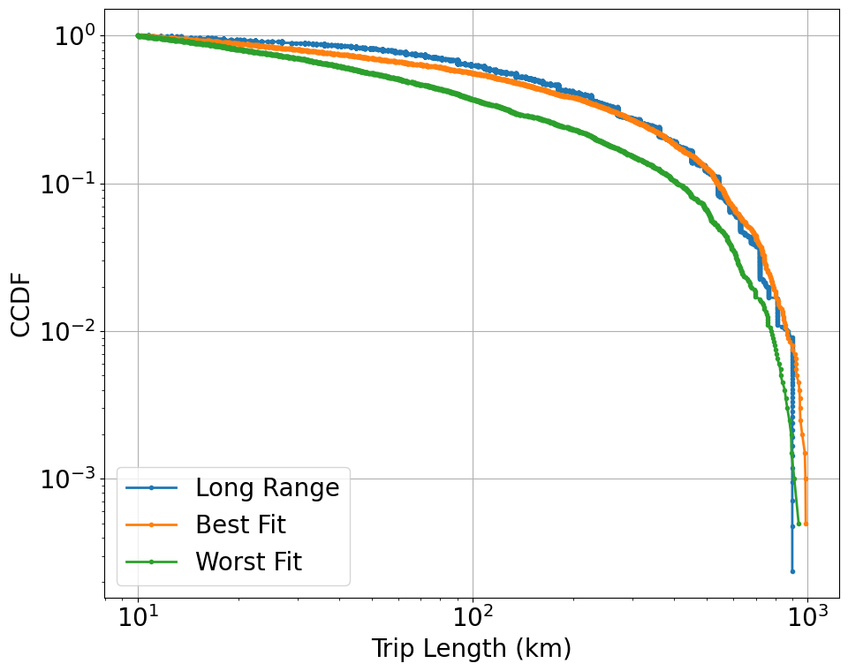
Long Range Public in MiD 2017 (Keep) Limited distances(10km~[500~1000km)) Dynamic Maximum Distance
Datasize=4199
Best fit error:
0.11186519940257483
Worst fit error
0.5971060068201868
eps_range=np.arange(0.9,1.2,0.02)
p_range=np.arange(0.7, 0.95, 0.01)
alp_range=np.arange(1.02,1.3,0.01)
Error: customized
Maximum Distance Selection: new uniformly
Samples:
Modelling (Visualization in the same time) 2000 →the error for fitting is the same error in the plot
 | eps | p | alpha
Hand picked
Best fit | 1.18 | 0.94 | 1.08
Worst fit | 0.94 | 0.7 | 1.3

Slide 32
Long Range Public in Nhts 2017 Limited distances(200km~[2600~5200km]) Dynamic Maximum Distance
Datasize=1700
Best fit error:
0.18388860715554078
Worst fit error
1.0532352544744417
eps_range=np.arange(0.8,1.8,0.1)
p_range=np.arange(0.7, 0.95, 0.01)
alp_range=np.arange(1.02, 2.5,0.1)
Error: customized
Samples:
Modelling (Visualization in the same time) 2000 →the error for fitting is the same error in the plot
 | eps | p | alpha
Hand picked
Best fit | 1.7 | 0.93 | 1.02
Worst fit | 0.8 | 0.7 | 2.32

Slide 33
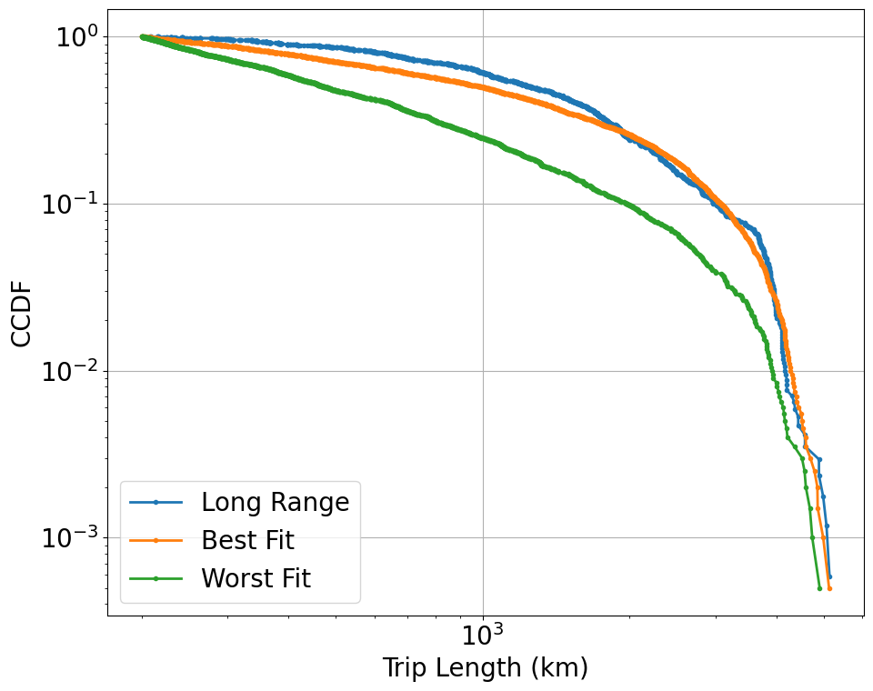
Long Range Public in Nhts 2017 Limited distances(200km~[2600~5200km]) Dynamic Maximum Distance
Datasize=1700
Best fit error:
0.17230215233523863
Worst fit error
0.8298207758475249
eps_range=np.arange(0.8,1.8,0.1)
p_range=np.arange(0.7, 0.95, 0.01)
alp_range=np.arange(1.02, 2.5,0.1)
Error: customized
Maximum Distance Selection: new uniformly
Samples:
Modelling (Visualization in the same time) 2000 →the error for fitting is the same error in the plot
 | eps | p | alpha
Hand picked
Best fit | 1.6 | 0.94 | 1.12
Worst fit | 0.8 | 0.71 | 2.12

Slide 34
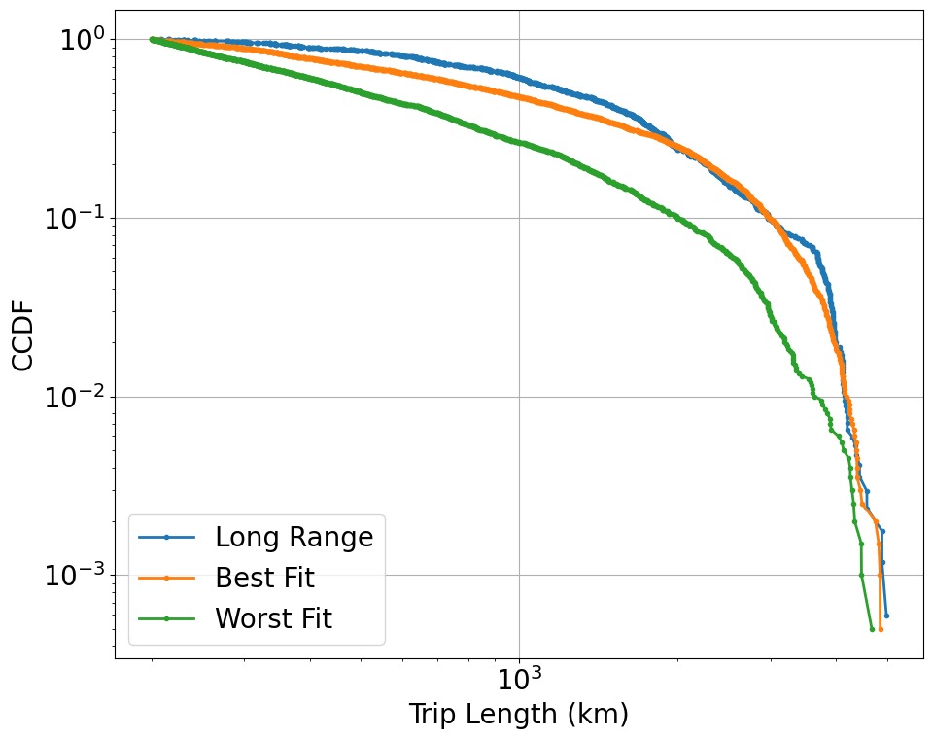
Long Range Public in Nhts 2017 (keep) Limited distances(200km~[2500~5000km]) Dynamic Maximum Distance
Datasize=1698
Best fit error:
0.16127530949279417
Worst fit error
0.9168537203866788
eps_range=np.arange(0.8,1.8,0.1)
p_range=np.arange(0.7, 0.98, 0.01)
alp_range=np.arange(1.02, 2.5,0.1)
Error: customized
Maximum Distance Selection: new uniformly
Samples:
Modelling (Visualization in the same time) 2000 →the error for fitting is the same error in the plot
 | eps | p | alpha
Hand picked
Best fit | 1.6 | 0.97 | 1.22
Worst fit | 0.8 | 0.74 | 2.02

Slide 35
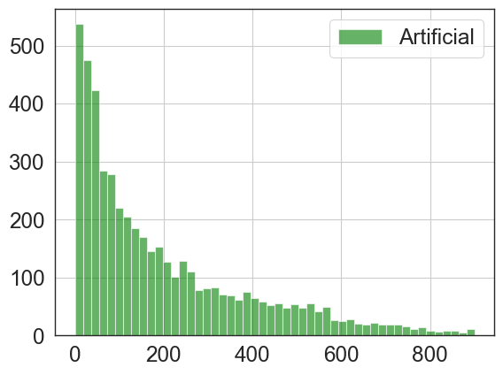
Histogram and Smoothing
Data: Long Range in MiD 2017
Bins=50
Average two neighbours
After smoothing, no raw data

Slide 36
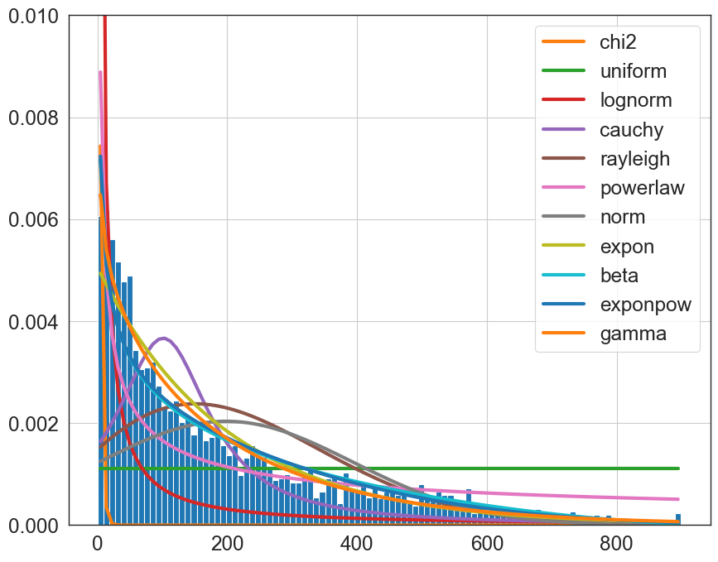
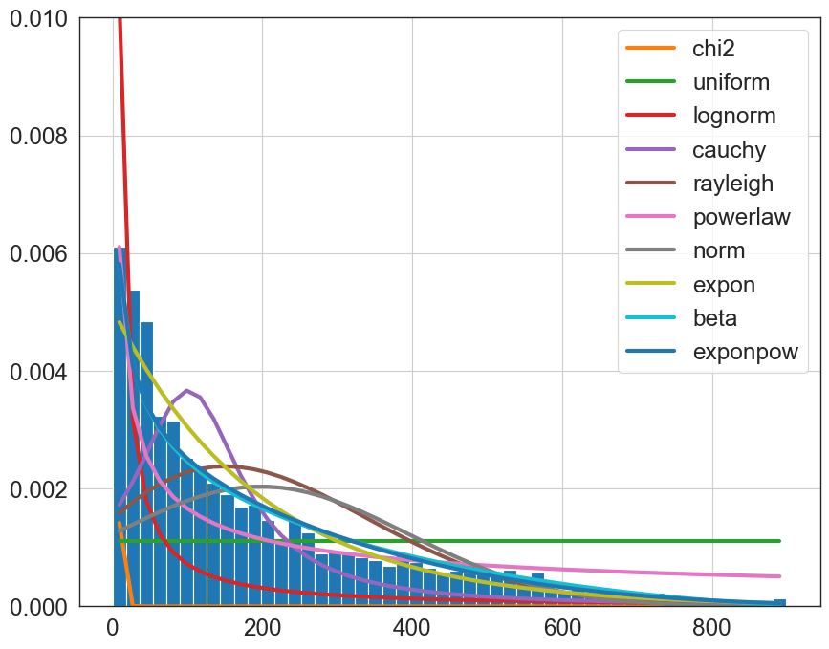
Possible Distributions to fit the Artificial Data (Long Range in MiD 2017) method='ks_pvalue'
100 bins histogram
50 bins histogram

Slide 37
Possible Distributions to fit the Data Long Range in MiD 2017
100 bins histogram
50 bins histogram

Slide 38
Previous

Slide 39
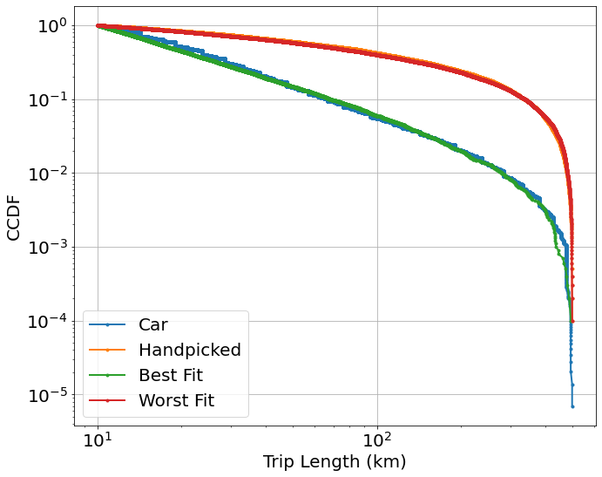
Car in MiD 2017 between 10km~500km
Datasize=144881
Best fit error:
2.7174564441843354
Worst fit error
91.45273924033827
eps_range=[1]
p_range=[0]
alp_range=np.arange(1.02, 2.5, 0.01)
Error: Wasserstein distance (the earth mover’s distance,)
# Samples:
Modelling(1000), Visualization(10000)
 | eps | p | alpha
Hand picked | 2 | 0.7 | 1.1
Best fit | 1 | 0 | 2.15
Worst fit | 1 | 0 | 1.03

Slide 40
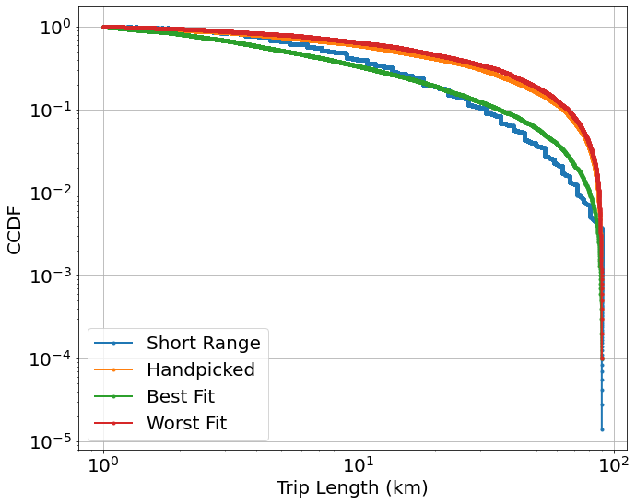
Short Range in MiD 2017 between 1km~90km
Datasize=71733
Best fit error:
1.8067714450328032
Worst fit error
14.54807936391029
eps_range=np.arange(0.5,2,0.05)
p_range=np.arange(0, 0.95, 0.05)
alp_range=np.arange(1.1, 2.5,0.1)
Error: Wasserstein distance (the earth mover’s distance,)
# Samples:
Modelling(1000), Visualization(10000)
 | eps | p | alpha
Hand picked | 2 | 0.7 | 1.1
Best fit | 0.8 | 0.55 | 1.6
Worst fit | 1.4 | 0.9 | 1.1

Slide 41
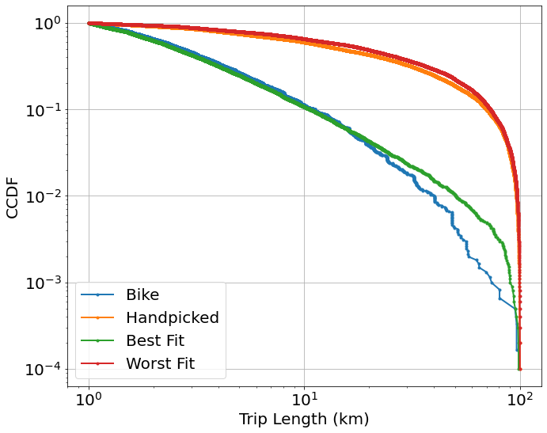
Bike in Nhts17 between 1~100km
Datasize=6065
Best fit error:
0.3119877108481111
Worst fit error
25.072634231951714
eps_range=np.arange(0.3,1.5,0.03)
p_range=np.arange(0, 0.95, 0.05)
alp_range=np.arange(1.02, 2.5,0.1)
Error: Wasserstein distance (the earth mover’s distance,)
# Samples:
Modelling(1000), Visualization(10000)
 | eps | p | alpha
Hand picked | 2 | 0.7 | 1.1
Best fit | 0.5 | 0.5 | 2.3
Worst fit | 1.6 | 0.9 | 1.1

Slide 42
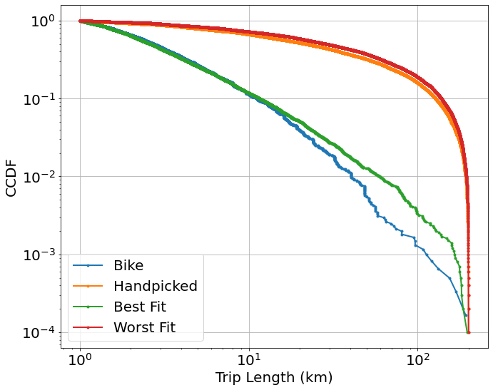
Bike in Nhts17 between 1~200km
Datasize=6072
Best fit error:
0.3870351265088589
Worst fit error
49.037702278559365
eps_range=np.arange(0.1, 2, 0.05)
p_range=np.arange(0, 0.95, 0.05)
alp_range=np.arange(1.1, 2.5,0.1)
Error: Wasserstein distance (the earth mover’s distance,)
# Samples:
Modelling(1000), Visualization(10000)
 | eps | p | alpha
Hand picked | 2 | 0.7 | 1.1
Best fit | 0.4 | 0.55 | 2.3
Worst fit | 1.6 | 0.9 | 1.1

Slide 43
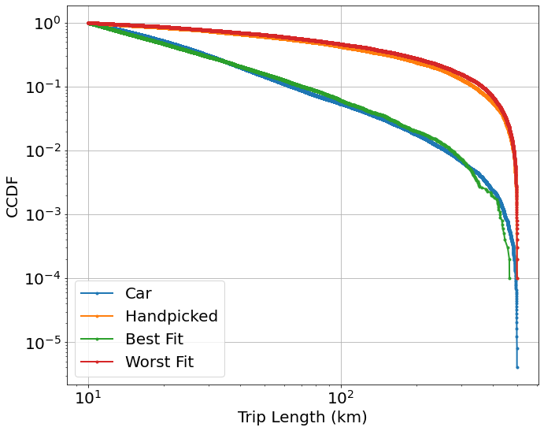
Car in Nhts17 between 10~500km
Datasize=247038
Best fit error:
1.4428930385889371
Worst fit error
111.62193019450247
eps_range=np.arange(0.1,2,0.05)
p_range=np.arange(0, 0.95, 0.05)
alp_range=np.arange(1.1, 2.5,0.1)
Error: Wasserstein distance (the earth mover’s distance,)
# Samples:
Modelling(1000), Visualization(10000)
 | eps | p | alpha
Hand picked | 2 | 0.7 | 1.1
Best fit | 0.3 | 0.7 | 2.4
Worst fit | 1.65 | 0.9 | 1.1

Slide 44
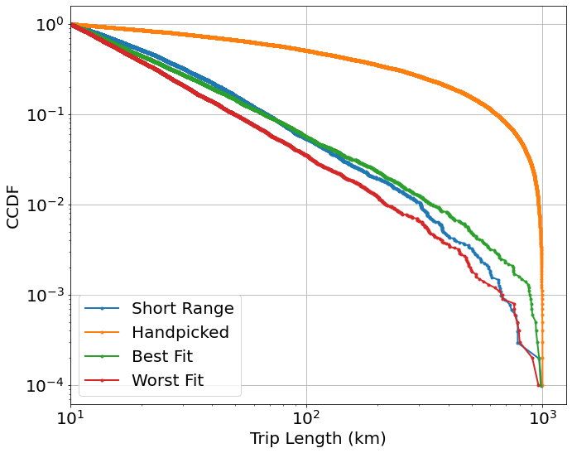
Short Range in Nhts17 between 10~1000km （keep）
Datasize=10223
Best fit error:
2.1135655984394757
Worst fit error
9.724983552616898
eps_range=np.arange(0.85,0.95,0.01)
p_range=np.arange(0.35, 0.45, 0.01)
alp_range=np.arange(2.4, 2.7,0.05)
Error: Wasserstein distance (the earth mover’s distance,)
Largest distance=1000 and shortest>=10
# Samples:
Modelling(2000), Visualization(10000)
 | eps | p | alpha
Hand picked | 2 | 0.7 | 1.1
Best fit | 0.89 | 0.4 | 2.45
Worst fit | 0.86 | 0.36 | 2.7

Slide 45
Modelling of Long Range Data

Slide 46
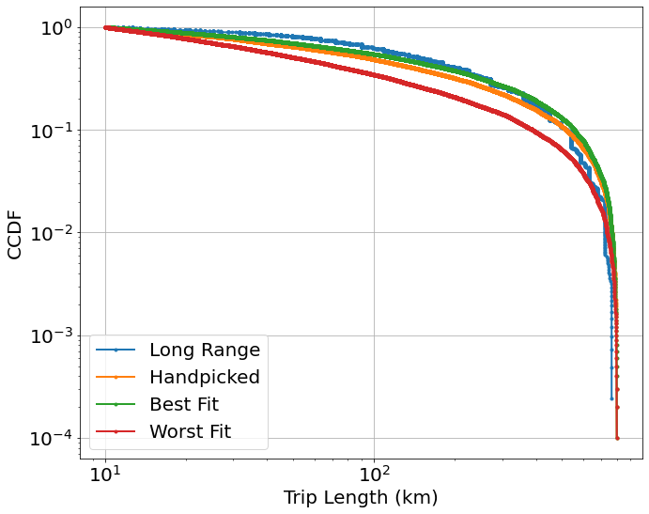
Long Range Public in MiD 2017 Limited range distances(10km~800km) selected for modelling (new)
Datasize=4129
Best fit error:
15.289252975521851
Worst fit error
101.36834407126533
eps_range=np.arange(0.3,1.5,0.03)
p_range=np.arange(0.7, 0.95, 0.03)
alp_range=np.arange(1.02, 1.3,0.01)
Error: Wasserstein distance (the earth mover’s distance)
Samples:
Modelling(1000), Visualization(10000)
 | eps | p | alpha
Hand picked | 2 | 0.7 | 1.1
Best fit | 0.51 | 0.94 | 1.04
Worst fit | 0.45 | 0.7 | 1.27

Slide 47

Long Range Public in Nhts17 Limited range distances(200km~5000km) selected for modelling
Datasize=1698
Best fit error:
208.76803608410893
Worst fit error
1044.3541416853718
eps_range=np.arange(0.1,2,0.05)
p_range=np.arange(0, 0.95, 0.05)
alp_range=np.arange(1.05, 2.5,0.05)
Error: Wasserstein distance (the earth mover’s distance)
Samples:
Modelling(1000), Visualization(10000)
 | eps | p | alpha
Hand picked | 2 | 0.7 | 1.1
Best fit | 1.6 | 0.9 | 2.35
Worst fit | 0.5 | 0.35 | 2.45

Slide 48

Long Range Public in Nhts17 Limited range distances(200km~5000km) selected for modelling
Datasize=1698
Best fit error:
250.3497826430402
Worst fit error
495.54404961892897
eps_range=[1]
p_range=[0]
alp_range=np.arange(1.02,1.5,0.01)
Error: Wasserstein distance (the earth mover’s distance)
Samples:
Modelling(1000), Visualization(10000)
 | eps | p | alpha
Hand picked | 2 | 0.7 | 1.1
Best fit | 1 | 0 | 1.05
Worst fit | 1 | 0 | 1.42

Slide 49
Covid 19

Slide 50

Coloring-LK Ahrweiler

Slide 51

Coloring-LK Ahrweiler

Slide 52

Coloring-LK Ahrweiler

Slide 53

Coloring-LK Ahrweiler
3 weeks as a roll
Increase: from white to red

Slide 54

Coloring-LK Ahrweiler
3 weeks as a roll
Increase: from white to red – different scale of color bar

Slide 55

Coloring-LK Ahrweiler
5 weeks as a roll
Red line: At least 4 weeks in which we have increased by a factor of 1.2

Slide 56

Coloring-LK Ahrweiler
5 weeks as a roll, Increase: from white to red
Red line: At least 4 weeks in which we have increased by a factor of 1.2

Slide 57
Incidence Formulas
Incidence= (New Cases) / (Population x Timeframe)
7-day incidence rate per 100,000
Cases in 7 days / Population x 100000
Berlin | Population | Percentage in Berlin
SK Berlin Charlottenburg-Wilmersdorf | 334401 | 0.091130
SK Berlin Friedrichshain-Kreuzberg | 282059 | 0.076866
SK Berlin Lichtenberg | 286522 | 0.078082
SK Berlin Marzahn-Hellersdorf | 262967 | 0.071663
SK Berlin Mitte | 375238 | 0.102259
SK Berlin Neukölln | 321123 | 0.087512
SK Berlin Pankow | 398036 | 0.108472
SK Berlin Reinickendorf | 259689 | 0.070770
SK Berlin Spandau | 239019 | 0.065137
SK Berlin Steglitz-Zehlendorf | 302177 | 0.082348
SK Berlin Tempelhof-Schöneberg | 341772 | 0.093139
SK Berlin Treptow-Köpenick | 266488 | 0.072623
Calculated from the original table: Fallzahlen_Kum_Tab_Archiv.xlsx
(https://www.rki.de/DE/Content/InfAZ/N/Neuartiges_Coronavirus/Daten/Inzidenz-Tabellen.html?nn=2386228)

